Slide 1








ODDO BHF Artificial Intelligence Participate in the AI revolution
JULY 2023
Launched in
2018
Assets under management
$ 309M
A global FUND INVESTED IN EQUITIES THAT benefit FROM ARTIFICIAL INTELLIGENCE, across a variety of sectors
One of the pioneer funds in the Artificial Intelligence (AI) thematic landscape: launch in 2018
A truly diversified fund: invested, far beyond Tech, in a broad range of sectors that will leverage AI to develop new products and services, according to us
A robust SFDR⁽¹⁾ article 9 strategy, based on decarbonization
“Using AI to invest in AI”: ODDO BHF Artificial Intelligence aims to leverage the analytical power of AI
The Fund may invest up to 50% of its net assets in equities whose registered office is located in non-OECD countries
Software
Hardware
Internet Media
Healthcare
Cyclical AI
Characteristics of the fund
Fonds | SFDR classification⁽¹⁾ | Summary risk indicator⁽²⁾ | NAV⁽³⁾ | Morningstar YTD⁽⁴⁾
ODDO BHF Artificial Intelligence |  |  | 151,16€ | Q2
6 | 8 | 9
1
2
3
4
5
6
7
Main Risks : ODDO BHF Artificial Intelligence is principally exposed to the following risks: risk of capital loss, equity risk, mid-cap holding risk, volatility risk, liquidity risk of underlying assets, modelling risk and currency risk. For more details about risks, please refer to page 5 of this document.
¹ The EU Sustainable Finance Disclosure Regulation (SFDR) is a set of EU rules which aim to make the sustainability profile of funds transparent, more comparable and better understood by end investors. Article 6: The management team does not consider sustainability risks or adverse effects of investment decisions on sustainability factors in the investment decision making process. Article 8: The management team addresses sustainability risks by integrating ESG criteria (Environment and/or Social and/or Governance) into its investment decision making process. Article 9: The management team follows a strict sustainable investment objective that significantly contributes to the challenges of the ecological transition, and addresses Sustainability Risks through ratings provided by the Management Company’s external ESG data provider. | ² Summary risk indicator: running from 1 to 7, where one is the lowest level of risk and seven the highest. This indicator shall be revised when changes occur in the fund’s risk and reward profile. | ³ CR-EUR share class | ⁴ Morningstar quartile of CR-EUR share class in category “Sector Equity Technology”
Source: ODDO BHF AM SAS | Data as of 30/06/2023
ODDO BHF Artificial Intelligence – July 2023

Slide 2










aI IS A revolution reshaping every industry
A POWERFUL TREND
AI, the ability of a program or machine to think & learn like a human, now allows for large productivity increases, regardless of companies’ size, sector and geography, according to our analysis
Adoption speed is thus set to significantly accelerate, from Tech companies firstly to then entertainment, media and pharma, in our opinion
+35.4%**
is the expected annual growth rate 2019-2026 of AI, while the global technology industry is expected to grow by only 10%***.
“In my lifetime, I’ve seen two demonstrations of technology that struck me as revolutionary.
The first time was in 1980, when I was introduced to a graphical user interface - the forerunner of every modern operating system, including Windows.
The second big surprise came just last year […] meeting with the team from OpenAI.”
Bill Gates - March 21st, 2023
Artificial Intelligence, getting closer to its ”iPhone moment”
ChatGPT bringing AI to the next level
Unprecedented speed of mass adoption
Easy access
Interaction in human language
Very quickly evolving technology
Virtually unlimited number of applications
Every industry can use it
For everyone: no need to be an IT expert any longer to access an Artificial Intelligence
Multi-modality: Inputs & Outputs can be plain text, video, sound, picture, etc.
AI becomes more affordable and higher performing
2022
5 days
2016
14 days
Path to 1M users for online services
2010
2.5 months
2008
5 months
2004
10 months
2006
2 years
1999
3.5 years
The fund is exposed to a risk of capital loss. Those companies are no investment recommendations
Source: ODDO BHF AM SAS, **PWC 2021, ***Gartner 2018, GatesNotes “The Age of AI has begun“, Statista, BofA Global Research, McKinsey, NextBigFuture, Gartner | Data as of 2023
ODDO BHF Artificial Intelligence – July 2023

Slide 3






Oddo bhf
Artificial intelligence
The fund offers our clients direct exposure to high-growth sub-themes encompassing all aspects of the artificial intelligence theme
Software
Hardware
Cyber Security
Analytics software
Cloud software
Saas Management software
5G Value chain
Internet of Things
Sensors
AI Processing
Internet Media
Healthcare
Social Network
Online retail & marketplace
Internet App
Video communication
Biopharma
Medtech
Tests & Diagnostics
Genome editing
Cyclical AI
Banks
Insurance
Industrials
Logistics
The fund is exposed to a risk of capital loss. These sector examples are not investment recommendations.
Source: ODDO BHF AM SAS
ODDO BHF Artificial Intelligence – July 2023

Slide 4

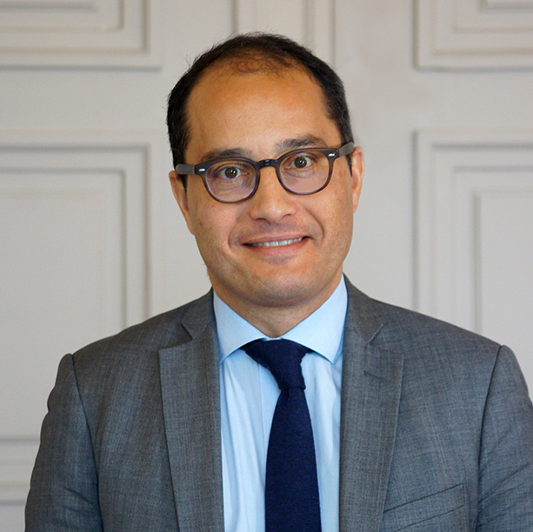
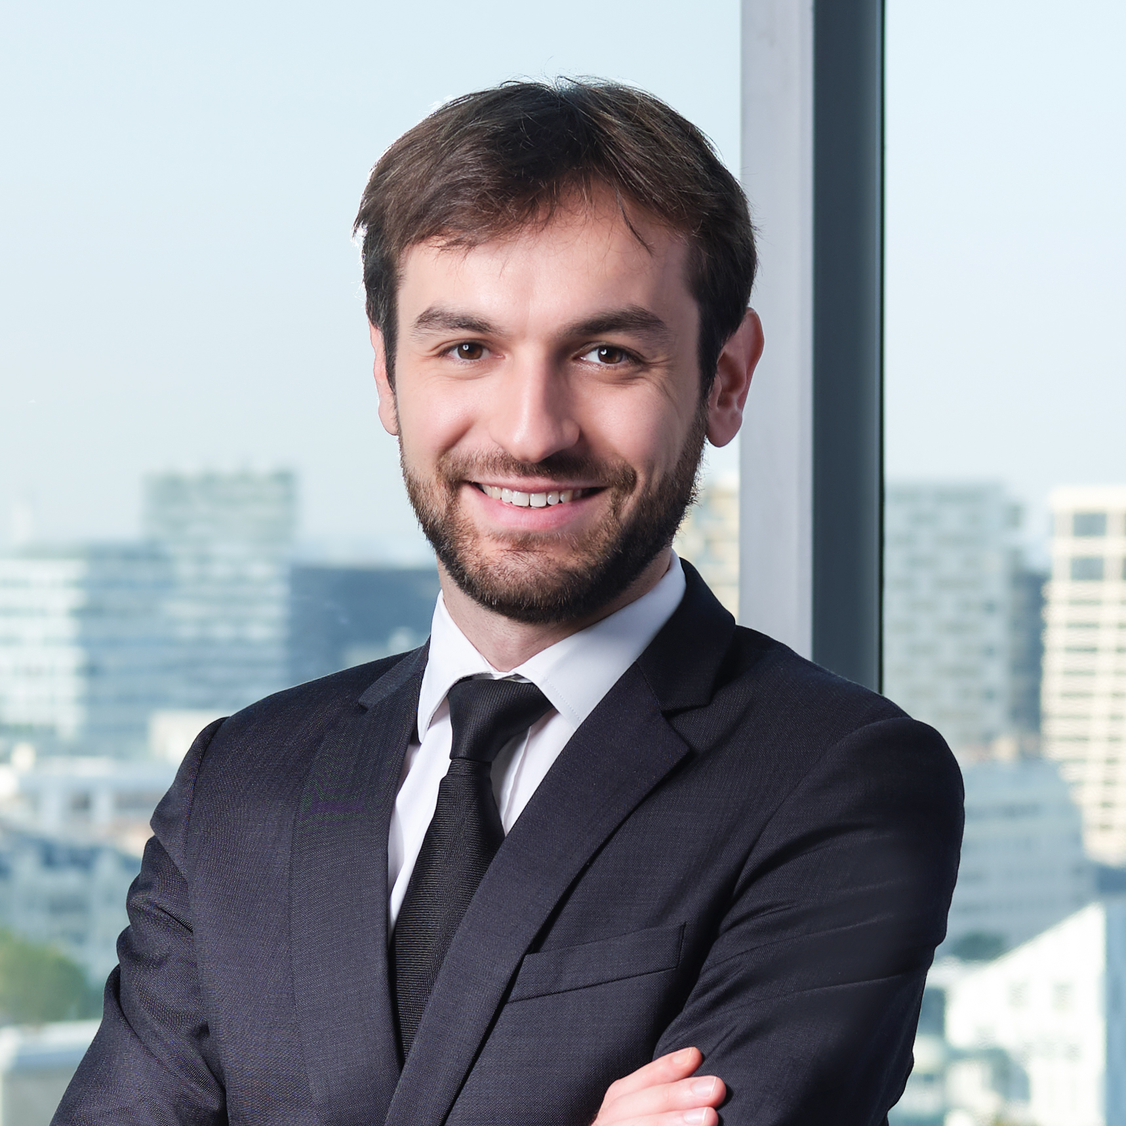
Human expertise enhanced by
Artificial Intelligence
Objective: invest in the best global listed equities linked to the theme
2
ESG FILTERS
3
Multifactor screening
Define our ESG investment universe
Investment universe linked to the AI theme
≈ 200 companies
Rank companies according to financial data
AI / Big Data analysis
3
4
1
1
Objective : Identify the most-promising companies linked to the AI theme
2
4
Portfolio construction & fundamental review
Global equities universe
≈ 6000 companies
Portfolio of 30 to 60 stocks*
A dedicated management team*
21
7
Brice Prunas
Equity Fund Manager
ODDO BHF Artificial Intelligence
ODDO BHF AM SAS
Maxence Radjabi, CFA
Equity Fund Manager
ODDO BHF Artificial Intelligence ODDO BHF AM SAS
Years of investment experience
* Management team, subject to change.
The fund is exposed to a risk of capital loss.
Source: ODDO BHF AM SAS | * the portfolio consists of 53 stocks as of 30/06/2023
ODDO BHF Artificial Intelligence – July 2023

Slide 5

Why invest IN ODDO BHF Artificial Intelligence
ACCORDING TO US ?
Fundamental expertise of the Portfolio managers enhanced by AI Stable team of experienced PMs managing our AI strategy since 2018, i. e. far before ChatGPT became fashionable Fundamental analysis, ESG criteria and valuation at heart of the investment process AI tool as an additional support for portfolio managers | Support the decarbonization of the economy A sustainable approach based on strong financial, thematic and ESG analysis An Article 9 fund with explicit decarbonization strategy, goals and KPIs
Exploiting unstructured data with AI Harnessing the analytical power of AI to go through millions of documents, interviews or reports published anywhere on the planet Aiming to detect early the relevant stocks globally Including small, young, poorly-covered and/or transitioning companies, regardless of home country | broadly diversified portfolio Direct exposure to Tech sub-segments most relevant for AI: software, hardware, Internet, Semiconductors, etc. Also invested in non-Tech sectors & stocks benefitting from AI: Life Science, Media, Healthcare, Finance, etc.
Risks
ODDO BHF Artificial Intelligence is mainly exposed to the following risks: Capital loss risk, equity risk, mid-cap holding risk, interest rate risk, credit risk, discretionary management risk, volatility risk, counterparty risk, liquidity risk of underlying assets, modelling risk, risk related to commitments on forward financial instruments, currency risk, emerging market risk, investment risk in China, stock connect, bond connect and sustainability risk.
The investor is invited to read the Key Information Document and the fund prospectus for detailed information concerning the risks to which the fund is exposed.
Source: ODDO BHF AM SAS | Data as of 2023
ODDO BHF Artificial Intelligence – July 2023

Slide 6
General characteristics
Fund name | ODDO BHF Artificial Intelligence | ODDO BHF Polaris Moderate
Benchmark index | MSCI World NR USD
Investment objective | Generate capital growth by investing in listed international equities that are exposed to the global trend of "artificial intelligence".
Recommended investment horizon | 5 years
Inception date | December 19 2018
Eligibility for the equity savings scheme PEA | No
Class of units | CR-EUR | Clw-USD
ISIN code | LU1919842267 | LU1833933325
Currency | EUR | USD
Dividend policy | Accumulation | Accumulation
Minimum initial subscription | EUR 100 | USD 250,000
Subscription fees | 5% maximum | 2% maximum
Management fees | Up to 1.6% of the net assets | Up to 0.95% of the net assets
Redemption fees | None | 0.5% (maximum)
Performance fees | A maximum of 20% of the Fund's outperformance relative to the benchmark index provided that the Fund’s performance is positive. | None
Structure and technical information
Legal structure | SICAV
Investment management company | ODDO BHF Asset Management SAS
Custodian | Caceis Bank Luxembourg (Luxembourg)
Subscription / redemption | Daily at unknown price until 12:00 p.m. (noon)
Valuation frequency | Daily
Authorised for distribution | France, Italy, Germany, Switzerland, Spain, Luxembourg, Sweden, Finland, Norway, Portugal, Belgium, Austria
ODDO BHF AM is the asset management division of the ODDO BHF Group. It is the common brand of four legally separate asset management companies: ODDO BHF AM SAS (France), ODDO BHF AM GmbH (Germany), ODDO BHF AM Lux (Luxembourg) and METROPOLE GESTION (France). This document has been drawn up by ODDO BHF ASSET MANAGEMENT SAS for market communication. Its communication to any investor is the exclusive responsibility of each distributor or advisor.
Potential investors should consult an investment advisor before subscribing to the fund. The investor is informed that the fund presents a risk of capital loss, but also many risks linked to the financial instruments/strategies in the portfolio. In case of subscription, investors must read the Key Information Document (KID) and the fund’s prospectus in order to acquaint themselves with the detailed nature of any risks incurred and all costs. The value of the investment may vary both upwards and downwards and may not be returned in full. The investment must be made in accordance with investors’ investment objectives, their investment horizon and their capacity to deal with the risk arising from the transaction. ODDO BHF ASSET MANAGEMENT SAS cannot be held responsible for any direct or indirect damages resulting from the use of this document or the information contained in it. This information is provided for indicative purposes and may be modified at any moment without prior notice.
Any opinions presented in this document result from our market forecasts on the publication date. They are subject to change according to market conditions and ODDO BHF ASSET MANAGEMENT SAS shall not in any case be held contractually liable for them.
The net asset values presented in this document are provided for indicative purposes only. Only the net asset value marked on the transaction statement and the securities account statement is authoritative. Subscriptions and redemptions of mutual funds are processed at an unknown asset value.
A summary of investor rights is available free of charge in electronic form in English language on the website at :
https://am.oddo-bhf.com/france/fr/investisseur_non_professionnel/infos_reglementaire
The fund may have been authorized for distribution in different EU member states. Investors are advised to the fact that the management company may decide to withdraw with the arrangements it has made for the distribution of the units of the fund in accordance with Article 93a of Directive 2009/65/EC and Article 32a of Directive 2011/61/EU.
The complaints handling policy is available on our website am.oddo-bhf.com in the regulatory information section. Customer complaints can be addressed in the first instance to the following e-mail address: service_client@oddo-bhf.com (or directly to the Consumer Mediation Service: http://mediationconsommateur.be (ONLY FOR BELGIUM))
The Key Information Document (French, English, Italian, German, Spanish, Portuguese, Swedish, Norwegian, Finnish) and the prospectus (French, German, English) are available free of charge from ODDO BHF ASSET MANAGEMENT SAS or at am.oddo-bhf.com or at authorized distributors. The annual and interim reports are available free of charge from ODDO BHF ASSET MANAGEMENT SAS or on its internet site am.oddo-bhf.com
The fund is licensed for sale in Switzerland. The Key Information Document, the prospectus, the annual and interim reports for Switzerland can be obtained free of charge from the Swiss Representative and paying agent, BNP Paribas Securities Services, succursale de Zurich, Selnaustrasse 16, 8002 Zurich, Switzerland.
ODDO BHF Asset Management SAS (France)
Portfolio management company approved by the Autorité des Marchés Financiers under GP 99011. Société par actions simplifiée with capital of € 21,500,000. Trade Register (RCS) 340 902 857 Paris. 12 boulevard de la Madeleine · 75440 Paris Cedex 09 France · Phone: +33 (0)1 44 51 85 00 · www.am.oddo-bhf.com
ODDO BHF Artificial Intelligence – april 2023

